Slide 1
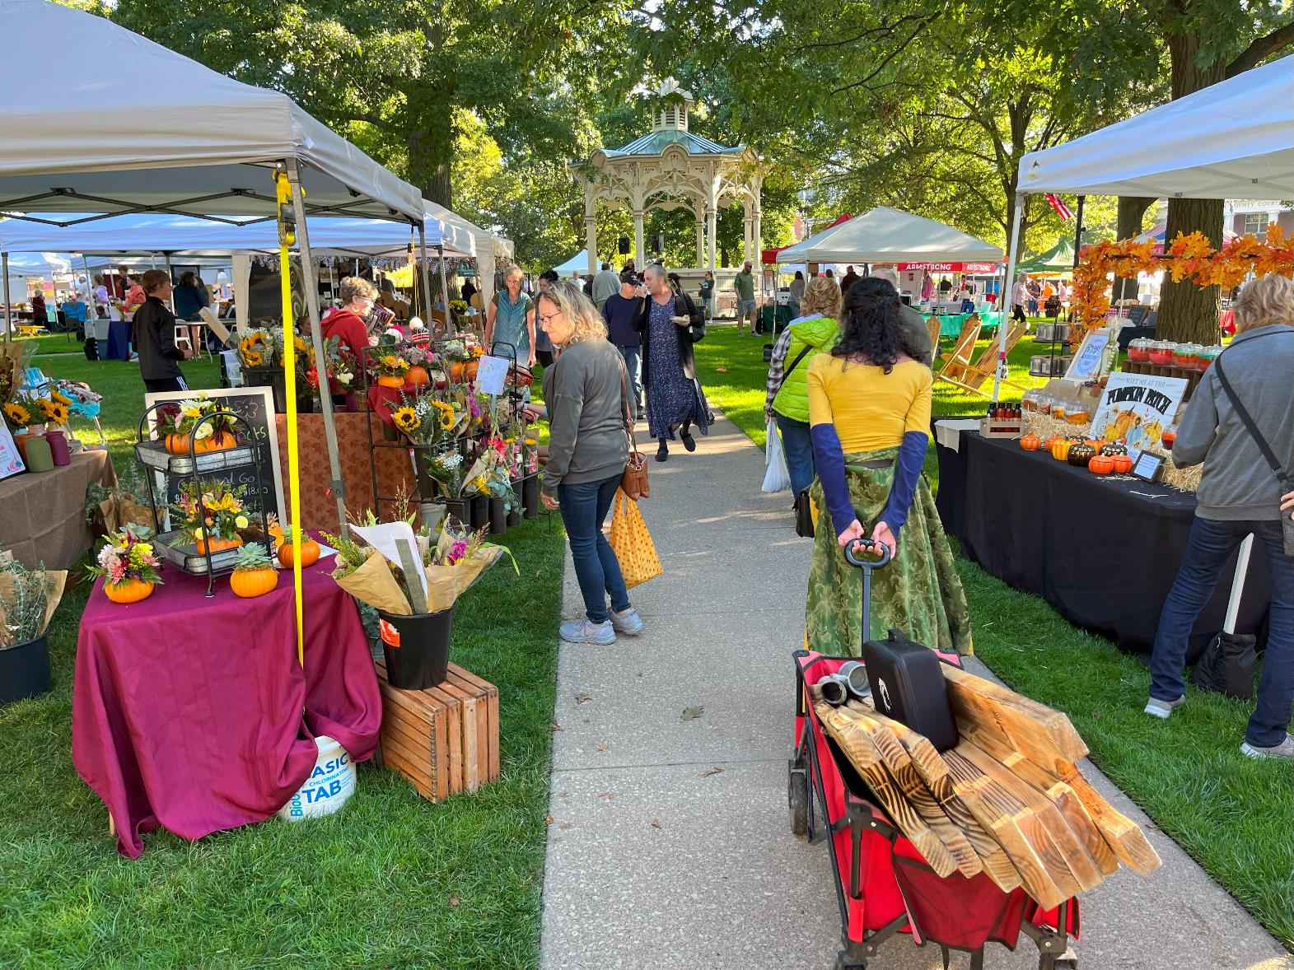
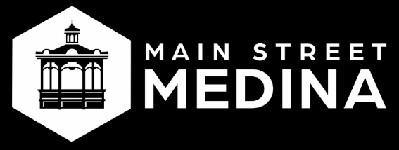
2023 Year in Review

Slide 2
Our Mission
To lead the effort for historic preservation, economic sustainability and continued evolution of our 12-block footprint as the heart of the community.
^{Our Vision}
“Be Ohio’s premier small-town destination.”

Slide 3
Strategic Goals
Diversify Sources of Funding
Raise Awareness for Main Street Medina;
Position the Historic District and South Town as a Destination
Connect & Engage Beyond our Boundaries; Be Inclusive of Diverse Audiences
Develop Advocacy Voice to Advance Business Vitality, Historic Preservation & Community Spirit

Slide 4
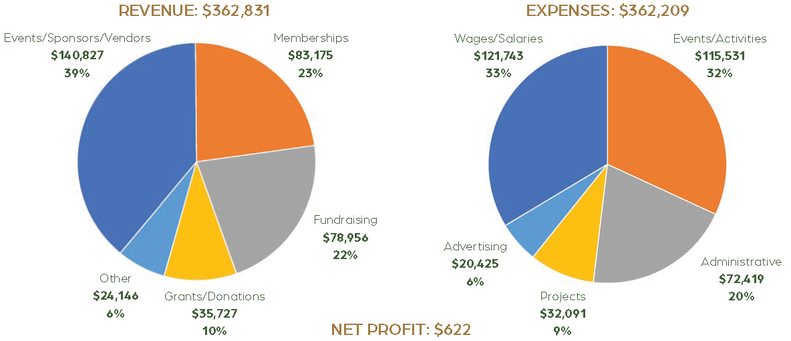
2023 Financial Report

Slide 5
2023 Highlights
35 MSM Sponsored Events
Replaced Medina Fest in July with Medina Fall Festival in September
21 Farmers Markets
Secured 73 vendors (53 full-time and 20 part-time vendors)
$10,486 in SNAP and Produce Perk redeemed
193,870 Visitors
Increased from 176,672 visitors in 2022
137,167 Website Visits / 83,534 Facebook Visits

Slide 6
2023 Highlights
2,663 Volunteer Hours
$84,683 donated value at $31.80 per workhour
$308,685 Donor Support
10.29:1 Return on City Investment of $30,000
$244,382 in 2022 (8.15:1 ROI)
203 Members
Includes 116 Small Businesses, 87 Families/Individuals
$3.88M Economic Impact
59:1 ROI based on $20 x 193,870 visitors spent locally

Slide 7
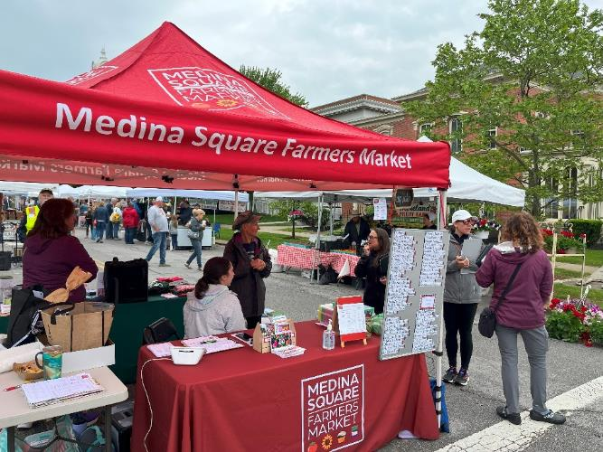
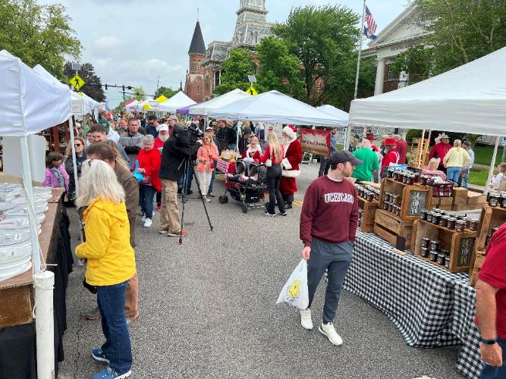
Signature Events
^{Medina Square Farmers Markets}

Slide 8
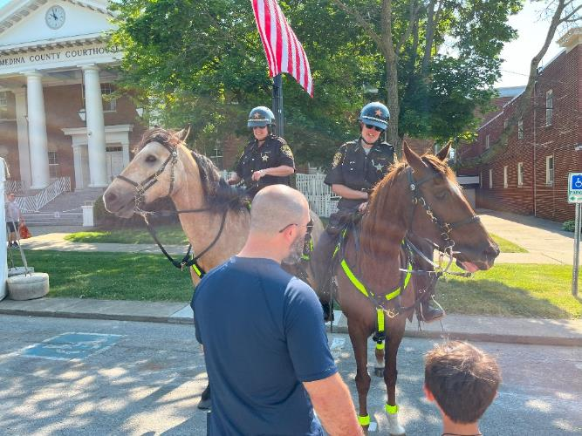
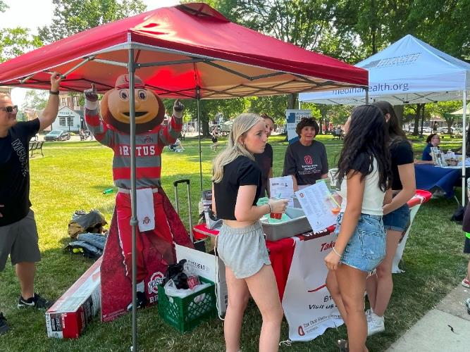
Signature Events
^{Kids Day & Teen Fest}

Slide 9
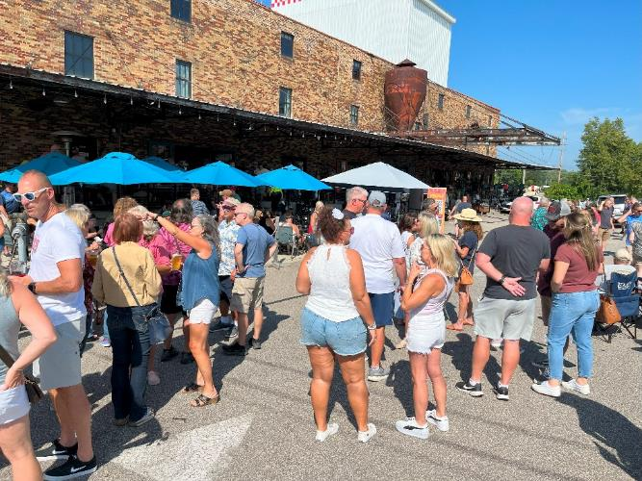
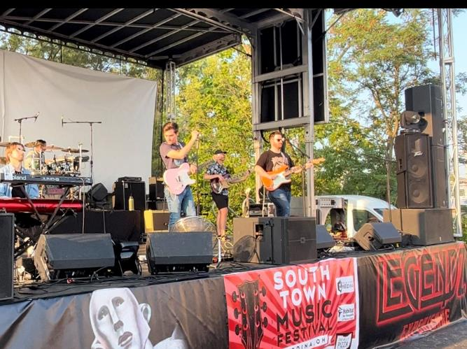
Signature Events
^{South Town Music Festival}

Slide 10
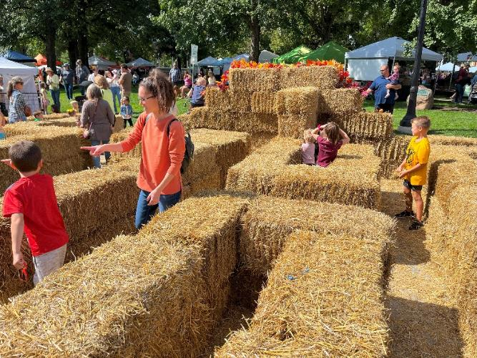
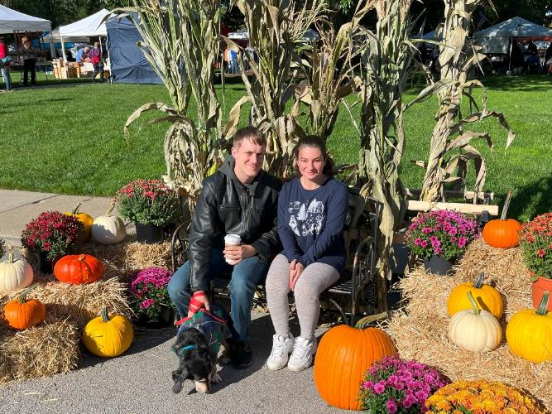
Signature Events
^{Medina Fall Festival}

Slide 11
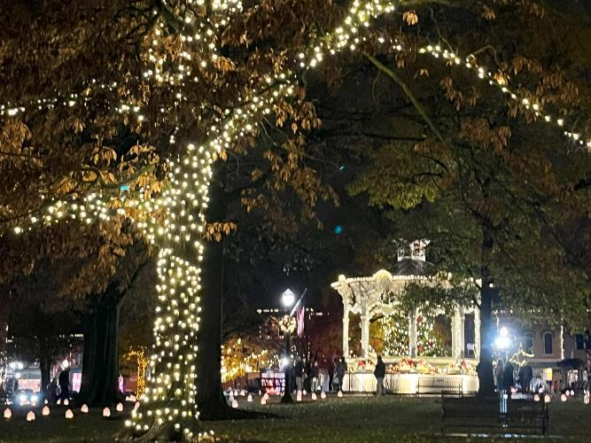
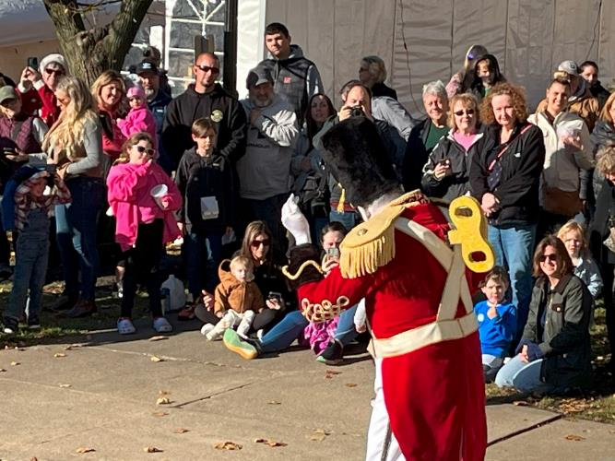
Signature Events
^{Medina Candlelight Walk}

Slide 12
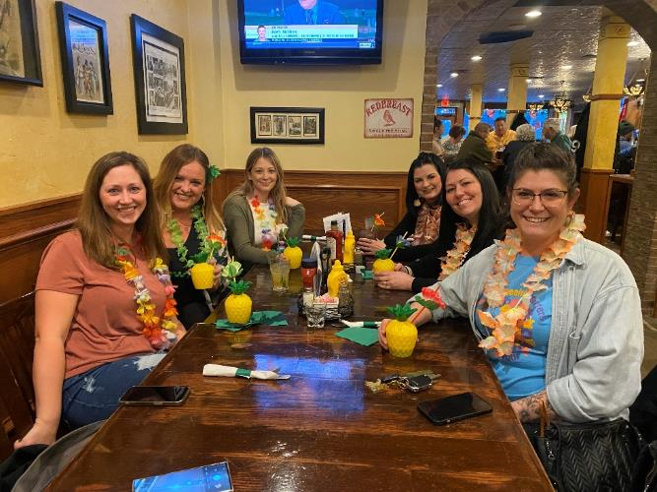
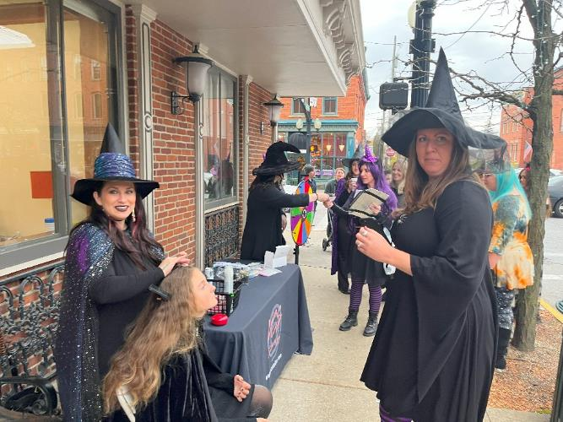
Promotional Events
^{Ladies Night Out}

Slide 13
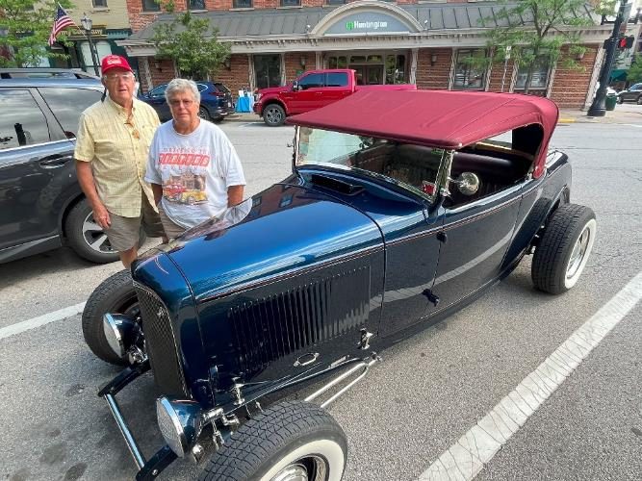
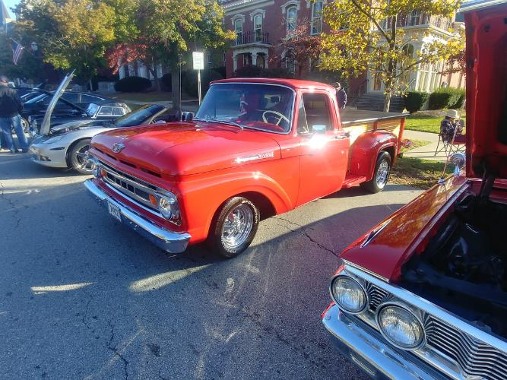
Promotional Events
^{Cars & Coffee}

Slide 14
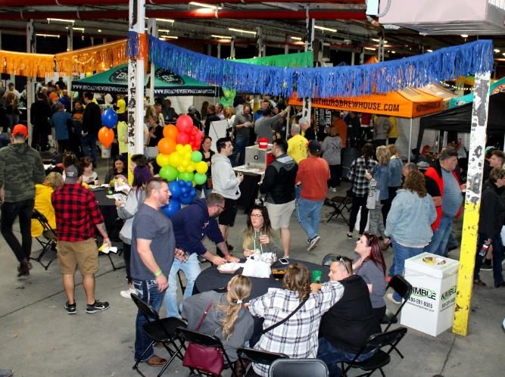
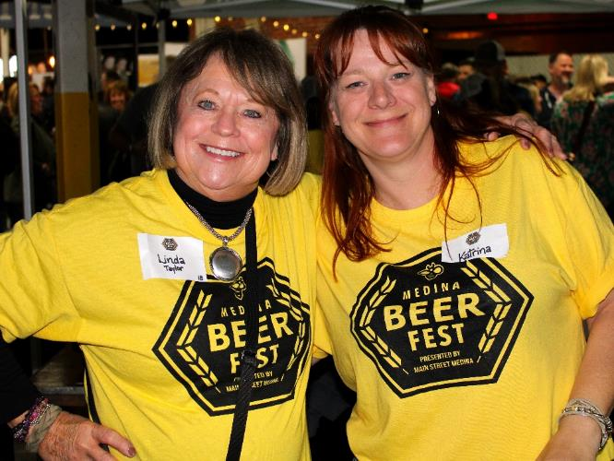
Fundraising Events
^{Medina Beer Fest}

Slide 15
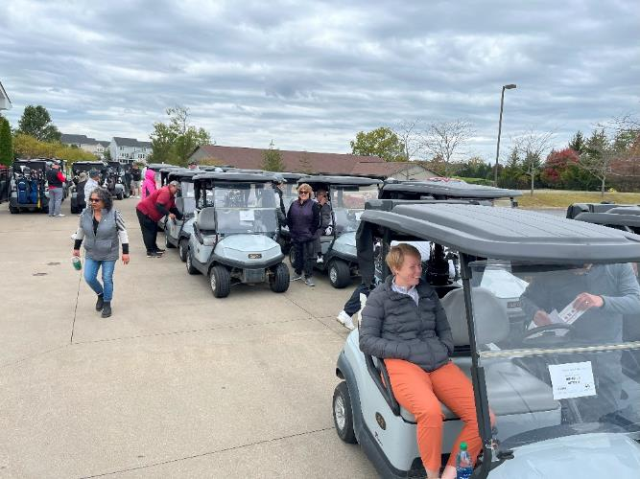
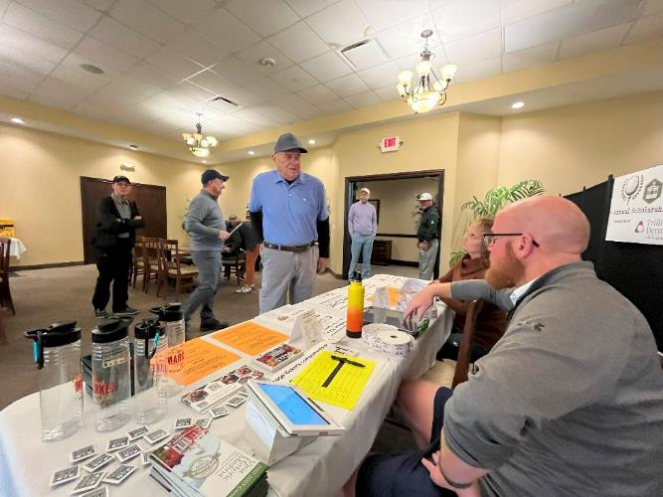
Fundraising Events
^{Scholarship Golf Outing}

Slide 16
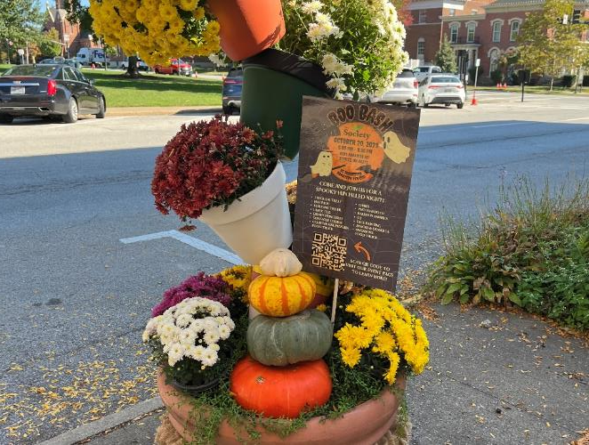
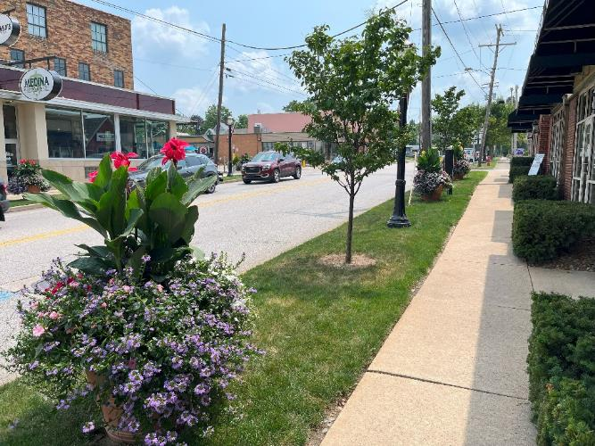
Streetscape Design
^{South Town & Fall Flower Pots}

Slide 17
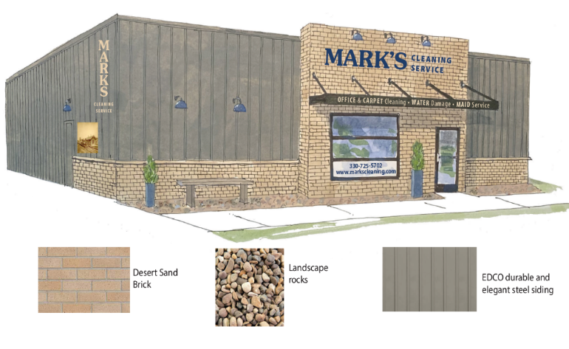
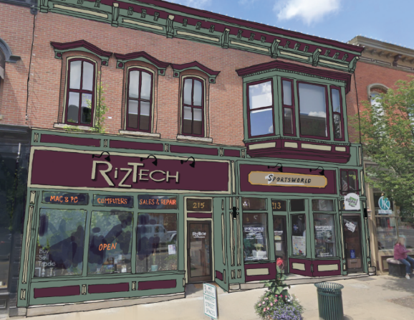
Façade Design
Mark’s Cleaning & Riztech Building

Slide 18
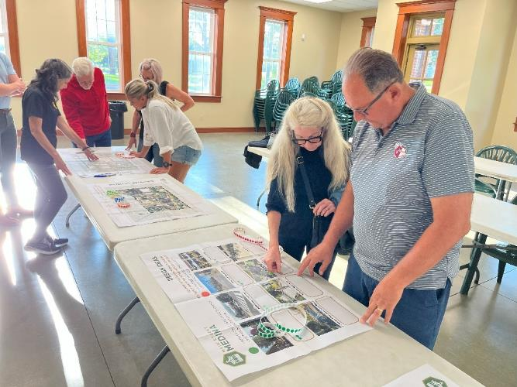
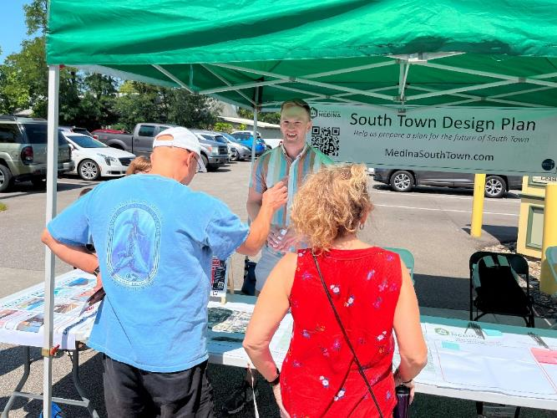
South Town Design Plan
^{Stakeholders & Public Input}

Slide 19
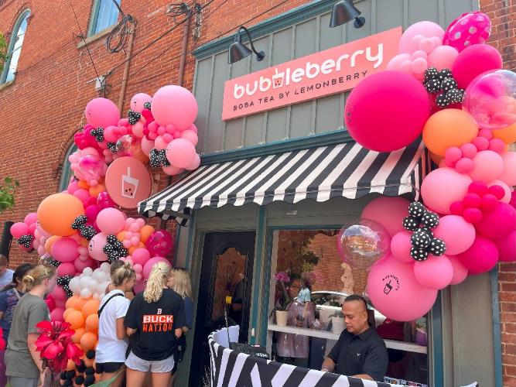
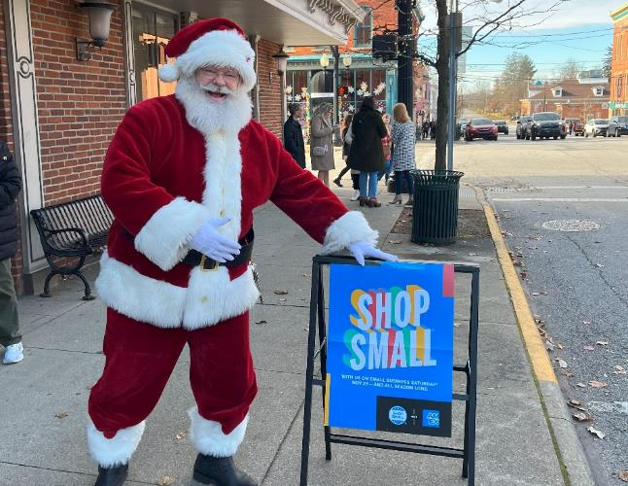
Economic Vitality
Ribbon Cuttings & Small Business Saturday

Slide 20
Outgoing Board Members
Amy Demlow
Brad Root
Jon Stahl
Leslie Traves
Stephanie Richardson

Slide 21
2024: A Look Ahead
Committees/Work Plans

Slide 22
2024 Board of Directors
Eric Stasiowski, Chair
Matt Liegl, Vice Chair
Becky Molnar, Treasurer
Amy Busby, Secretary
Ali Burmeister
Sam Custer
Andrew Dutton
Steve Hambley
Jason Morgan
Michele Nichols
Kelly Parks
Tracey Ruffin
Easton Saltsman
Andrew Schuler
Christine Sheerer
Ex-Officio:
Jake Emling, Kevin Hutchinson
Kimberly Marshall, Kevin Rych

Slide 23
MSM Board of Directors:
Strategic Planning
Develop direction and maintain “balance”
Policies & Procedures
Review & revise contracts, handbooks, documents
Finance & Investments
Research opportunities to grow earnings & diversify funds
Succession Planning
Develop a more diverse pool of volunteers, committees,
chairs to become board members

Slide 24
Promotions Committee:
Signature Events
Farmers Markets – May 18-Oct 5
Kids Day & Teen Fest – June 1
South Town Music Festival – Aug 10
Medina Fall Festival – Sep 28
40th Candlelight Walk – Nov 22-24
Ladies Night Out – Mar 14, May 9, July 25, Oct 17
Cars & Coffee – Apr 21, Jun 16, July 28, Oct 13

Slide 25
Promotions Committee:
Partnership Events
Restaurant Week – Oct 4-13
Ice Festival – Feb 16-19
Student Art Show – Mar 1-31
Solar Eclipse – Apr 8
Pride Day – Jun 13
Juneteenth – June 15

Slide 26
Organization Committee:
Fundraising Events
Annual Mtg/Casino Night – Jan 24
Beer Fest – Apr 27
Scholarship Golf Outing – Oct 14
Annual Appeal – Nov 26-Dec 31
Maintain/Recruit Members
Train/Recruit Volunteers

Slide 27
Economic Vitality Committee:
Support Businesses
Surveys, workshops, marketing, resources
Provide Entrepreneur Support
Match businesses with vacancies, welcome new businesses
Seek Transit Opportunities
Research private transit firms for weekend loop service
Collect Marketing Research
Contract with Placer AI/H.O. to provide visitor & sales data
Direct Mail Campaign
Target new customers with seasonal postcards

Slide 28
Design Committee:
Develop South Town District
Focus areas: 1) Gateway, 2) Mill Street, 3) Pocket Park
Research Public Art in South Town
Research potential for murals, art installations, etc.
Develop Façade Design & Rehab Program
Recommend designs, seek funding support
Improve Historic District Streetscape
Research amenities & signage to enhance visitor experience
Evaluate Conditions
Assess property/public space within MSM footprint

Slide 29
Thank You
For Your Continued Support!

